Slide 1
Introduction
F28DM Database Management Systems
Phil Bartie
Based on material from Alasdair Gray , Monica Farrow

Slide 2

Materials released under CC-BY License
You are free to:
Share — copy and redistribute the material in any medium or format
Adapt — remix, transform, and build upon the material for any purpose, even commercially.
The licensor cannot revoke these freedoms as long as you follow the license terms.
Under the following terms:
Attribution — You must give appropriate credit, provide a link to the license, and indicate if changes were made. You may do so in any reasonable manner, but not in any way that suggests the licensor endorses you or your use.

Slide 3
Topics in this Lecture
Basic definitions
Database
Database Management System
Database system architecture
Data independence
Database people
Database System Lifecycle

Slide 4
BACKGROUND to DATABASES

Slide 5
Overview of a Typical Project
Observation / Idea
Hypothesize
Design Experiments
Conduct Experiments / Collect Data
Analyse Data
DATA

Slide 6
Data Driven Research
Alternative approach
observations
analyse data
detect pattern
theory
Data!!

Slide 7
Data Science
“A scientific model should be as simple as possible, but no simpler” – Albert Einstein
“All models are wrong, but some are useful” – George Box
“The two most important things in Data Science are the data and the science” - @KirkDBorne (Twitter)
Notes:
Data science is big business…. Lots of jobs for data scientists… take data.. Build models… look for patterns..

Slide 8

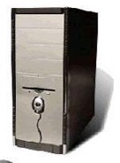
It’s all about the DATA…
Capture
Store
Edit
Analyze
Share
Display
‘80% of data has a spatial component’
- Robert E. Williams (1987)
Notes:
Data is / are very important… you can get a new PC if one breaks… you can download new software… but if you lose your data and it isn’t backed up then big loss of work.
Data includes your python or java code…. You word or latex documents… your excel spreadsheet… your database datasets…
A good way to handle large volumes of data… is a database… so…{next slide]

Slide 9
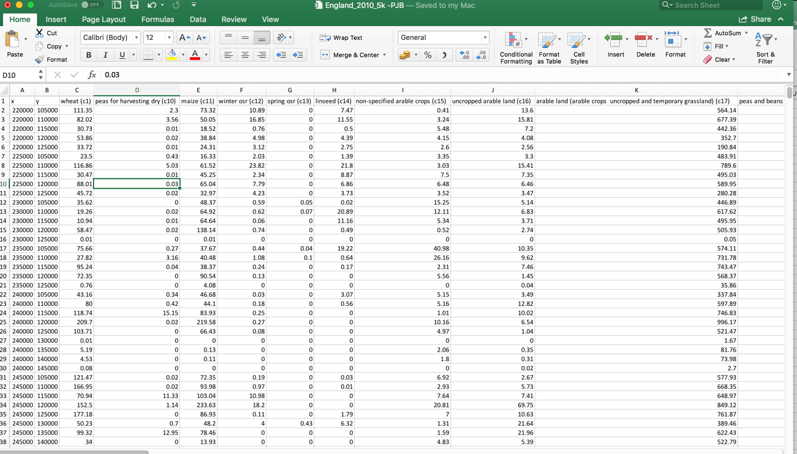
Flat File Data Structure
e.g. Excel spreadsheet or a CSV file
Notes:
One way to store data is as a comma separate value (CSV) file… or Excel spreadsheet..
But it has limitations… such as number of rows it can store… speed of searching for a value….
Duplication of values…
Only 1 person can edit at a time… as the entire file is locked…

Slide 10
What is a Database? What is a DBMS? What is a Database System? What are examples of each of these?
Discuss
Notes:
A Database is a collection of inter- related data organized in a way that data can be easily accessed, managed and updated
A database management system (DBMS) is a collection of programs that enables users to create and maintain a database.
Examples:
Database – university student database (names, home addresses, term time address, photo, marks for each module taken, fees)
- Trip Advisor ; Netflix; Facebook Messenger all have databases in the background to manage the data
- payment data (e.g. contactless payments) involves banks moving money between accounts => databases
- sensor data (e.g. you are a sensor if you use Google maps to navigate –sending them information they can use for traffic flow rates – find congested roads)
Database Management System (DMBS)
Relational: Oracle, SQLServer, DB2, MySQL, PostGreSQL, …
Others: MongoDB, neo4j, eXist, Cassandra, HBase, …

Slide 11
Database System
User
User
User
User
User
User
User
User
User
Database System
Application Program
Application Program
Queries
DBMS
Database
Notes:
Database collection of logically related data
Database Management System (DMBS) is a software system designed for the creation and management of Databases.
Relational: Oracle, SQLServer, DB2, MySQL, PostGreSQL, …
Others: MongoDB, neo4j, eXist, Cassandra, HBase, …
Relational Database Management System (RDBMS) stores the data using Relations (the first part of this course)
Database Application is a program that interacts with a database during its execution.
Database System is the Database together with the DBMS and associated application

Slide 12
Definitions
A Database is a collection of logically related data for a particular domain.
A Database Management System (DMBS) is a software system designed for the creation and management of Databases.
Relational: Oracle, SQLServer, DB2, MySQL, PostgreSQL, …
Others: MongoDB, neo4j, eXist, Cassandra, HBase, …
A Relational Database Management System (RDBMS) stores the data using Relations (the first part of this course)
A Database Application is a program that interacts with a database during its execution.
A Database System is the Database together with the DBMS and associated application

Slide 13







RDBMS
Relational Database Management System
Microsoft Access
+ others…
Notes:
Anyone heard of any of these?
Anyone used any of these? All have…. Every time you use a debit card… bank transactions… web sites…
There are NOSQL databases – not going to talk about those today…
Vs flat file

Slide 14
Databases
CRUD – Create, Read, Update, Delete
Support multiple concurrent users
Locking at Record level or Table
Secure – user level permissions
Handle very large datasets (PostgreSQL = 1GB per field; 32TB per table; unlimited DB size)
+ lots more

Slide 15
So why not just use a FLAT FILE??
unique identifier
Entity
Primary Key
Attributes
Degree
(number of attributes [7])
ROW_ID | NAME | CITY | STYLE | WINE | COUNTRY_ORIGIN | PRICE
1 | Via Duct Restaurant | London | Italian | Gibbston Valley Pinot Gris | New Zealand | £23
2 | Via Duct Restaurant | London | Italian | Chateau Beaulieu | France | £20
3 | Dux de Lux | London | Sea Food | Gibbston Valley Pinot Gris | New Zealand | £25
4 | Dux de Lux | London | Sea Food | Beresford Chardonnay | Australia | £32
5 | Pompino | Edinburgh | Sea Food | Melness Riesling | New Zealand | £0
6 | Pompino | Edinburgh | Sea Food | Beresford Chardonnay | Australia | £30
Tuple / Record
Cardinality
(number of tuples [6])
Value
Notes:
Just to give you an idea of how relational databases are used to store data….
We’ll go through the stages in more detail during the course.. But conceptually imagine you had a dataset like this….
You could store as a single Excel spreadsheet… but there are some reasons why this isn’t a good idea… you have a lot of data duplication – meaning if some record changed then you’d have to do a big FIND & REPLACE throughout the file.
Also it takes up more disk space… which is OK for a small dataset but how about if you have millions, or billions of records…. How long would a FIND & REPLACE take then…?

Slide 16
Storing data as 2 entities to avoid data duplication
1 to many relationship [1:N] (eg one city can have many restaurants but a restaurant can’t be in many cities)
Primary Key
Foreign Key
ROW_ID | NAME | CITY_ID {FK} | STYLE | WINE | COUNTRY_ORIGIN | PRICE
1 | Via Duct Restaurant | 1 | Italian | Gibbston Valley Pinot Gris | New Zealand | £23
2 | Via Duct Restaurant | 1 | Italian | Chateau Beaulieu | France | £20
3 | Dux de Lux | 1 | Sea Food | Gibbston Valley Pinot Gris | New Zealand | £25
4 | Dux de Lux | 1 | Sea Food | Beresford Chardonnay | Australia | £32
5 | Pompino | 2 | Sea Food | Melness Riesling | New Zealand | £30
6 | Pompino | 2 | Sea Food | Beresford Chardonnay | Australia | £30
N
Data Duplication
Primary Key
1
CITIES
CITY_ID | NAME
1 | London
2 | Edinburgh
Restaurants
Wines

Slide 17
Storing data as 4 entities to avoid data duplication (relationships 1:1 1:N N:M)
N
RESTAURANT
REST_ID | NAME | CITY_ID {FK} | STYLE
1 | ViaDuct Restaurant | 1 | Italian
2 | Dux de Lux | 1 | Sea Food
3 | Pompino | 2 | Sea Food
1
CITY
CITY_ID | NAME
1 | London
2 | Edinburgh
One to Many
A restaurant instance can only be in 1 city…
…. Each city can have many restaurants
N
Compound key
The same wine can be sold in many restaurants .. Each restaurant can sell many bottles of wine
Many to Many
REST_WINE
REST_ID | WINE_ID | PRICE
1 | 1 | £23
1 | 3 | £20
2 | 1 | £25
2 | 2 | £32
3 | 4 | £30
3 | 2 | £30
WINE
WINE_ID | NAME | COUNTRY_ORIGIN
1 | Gibbston Valley Pinot Gris | New Zealand
2 | Beresford Chardonnay | Australia
3 | Chateau Beaulieu | France
4 | Melness Riesling | New Zealand
M
Notes:
A compound key is a key that consists of 2 or more attributes that uniquely identify an entity occurrence.
Each attribute that makes up the compound key is a simple key in its own right.

Slide 18
Still have some data duplication…..
N
RESTAURANT
REST_ID | NAME | CITY_ID {FK} | STYLE
1 | ViaDuct Restaurant | 1 | Italian
2 | Dux de Lux | 1 | Sea Food
3 | Pompino | 2 | Sea Food
1
CITY
CITY_ID | NAME
1 | London
2 | Edinburgh
N
REST_WINE
REST_ID | WINE_ID | PRICE
1 | 1 | £23
1 | 3 | £20
2 | 1 | £25
2 | 2 | £32
3 | 4 | £30
3 | 2 | £30
WINE
WINE_ID | NAME | COUNTRY_ORIGIN
1 | Gibbston Valley Pinot Gris | New Zealand
2 | Beresford Chardonnay | Australia
3 | Chateau Beaulieu | France
4 | Melness Riesling | New Zealand
M

Slide 19
Storing data as 6 entities to avoid data duplication
CITY
CITY_ID | NAME
1 | London
2 | Edinburgh
1
N
RESTAURANT
REST_ID | NAME | CITY_ID {FK} | STYLE_ID
1 | ViaDuct Restaurant | 1 | 1
2 | Dux de Lux | 1 | 2
3 | Pompino | 2 | 2
N
1
COUNTRY
COUNTRY_ID | COUNTRY
1 | New Zealand
2 | Australia
3 | France
STYLE
STYLE_ID | STYLE
1 | Italian
2 | Sea Food
N
1
REST_WINE
REST_ID | WINE_ID | PRICE
1 | 1 | £23
1 | 3 | £20
2 | 1 | £25
2 | 2 | £32
3 | 4 | £30
3 | 2 | £30
N
M
WINE
WINE_ID | NAME | COUNTRY_ORIGIN {FK}
1 | Gibbston Valley Pinot Gris | 1
2 | Beresford Chardonnay | 2
3 | Chateau Beaulieu | 3
4 | Melness Riesling | 1

Slide 20
8 Essential Services (Codd 1982)
Data storage, retrieval and update
A user-accessible catalog containing descriptions of data items
Transaction support
If transaction has multiple parts, either all or none are done
Concurrency control services
Recovery services
Authorization services
Support for data communication (over network)
Integrity services – ensures correctness of stored data

Slide 21
RDBMS Architecture
SQL Queries
DBMS
Query Processor
Query Parser
Logical Optimiser
Physical Optimiser
Code Generator
Storage Manager
Buffer Manager
Disk Manager
Security Control
Transaction Manager
Database
Data Files
Catalog
Logs
Index Structure
Notes:
SQL Interface presents tabular view
Query processor: converts SQL into processable statements
Storage Manager: Locks, transactions, recovery, security, memory management, file buffer management
Database: storage on disk

Slide 22
DBMS Components
A DBMS is a complicated software system containing many components:
Query processor - translates user/application queries into low level data manipulation actions.
Sub-components: query parser, query optimizer
Storage manager - maintains storage information including memory allocation, buffer management, and file storage.
Sub-components: buffer manager, file manager, security controller, transaction manager (performs scheduling of operations and implements concurrency control algorithms)
Database – stores data on disk
Sub-components: Data files, catalog files, logs, index structure

Slide 23
ANSI-SPARC Three Tier Architecture
Application View
Application View
Application View
Application View
Logical Schema
Logical Data Independence
Physical Data Independence
Physical Schema
Database
Notes:
Stored in system catalog
Logical schema: tables, data types, keys, constraints, etc
Physical schema: file names, indexes, access methods
Database: files on disk
Application view: restrict access to the data – security
Data Independence: Logical and Physical

Slide 24
ANSI-SPARC Three Tier Architecture
External Level (Application Views)
Describes a part of the database that is relevant to a particular user. It excludes irrelevant data as well as data which the user is not authorised to access.
Conceptual Level (Logical Schema)
Describes what data is stored within the whole database and how the data is inter-related.
Does not specify how the data is physically stored.
Internal Level (Physical Schema)
How the database is physically represented on the computer system. How the data is actually stored in the database and on the computer hardware.

Slide 25
Data Independence
“To Insulate applications from how data is structured and stored”
Physical data independence
The format and organisation of the data can be altered without having to change the conceptual view or the applications that use it
Changes are usually made to improve performance.
DBMS achieve physical data independence.
Logical data independence
The conceptual schema can be altered without having to change the applications that use it.
E.g. An attribute ‘first names’ could be altered to ‘first name’ and ‘middle name’, but a View could be used to present the data conceptually in the same way.
DBMS achieve logical data independence for minor changes. Major changes will have a knock-on effect.
E.g. Changing a one-to-many relationship to many-to-many

Slide 26
Database System Users
Number of individuals
End Users
Application Developers
DBA
Database
Knowledge of database
Notes:
DBA: Manages database, schema design, tuning performance
App Dev: Support user interactions with the data, wrap complexity of querying
Users: Interested in the data
Number of individuals/Amount of knowledge: How many users of facebook? How much do they know of the system?

Slide 27
Database System Users
End User: The people who utilise the content of the database through applications. Typically little to no knowledge of the underlying database.
Application Developers: The people who deliver the applications to the end users. Their software will query, and potentially update, the content of the database. They need to be aware of the logical schema/view exposed to their application.
Database Administrator (DBA): Manages the database. Detailed and extensive knowledge of the database:
Designs logical and physical schemas
Database tuning as needs evolve: adding indexes, evolving schemas
Controls security and authorisation through access control
System availability, backup, and recovery

Slide 28
Development Lifecycle
System Aims and Definition
Requirement collection and analysis
Application Design
Database design:
Conceptual, Logical, and Physical
DBMS selection
Prototyping and Implementation
Data loading
Testing
Deployment
Maintenance
Notes:
(A lot behind these boxes, see notes for full details)
Enterprise goals for data
Stakeholder requirements, system boundaries
Database design and selection of DBMS
App design: queries
Data loading: transfer data from existing system to new system
Deployment: run system beside existing system

Slide 29
Development Lifecycle: System Aims and Definition
System Aims and Definition
Requirement collection and analysis
Database design:
Conceptual, Logical, and Physical
DBMS selection
Determine enterprise goals and information needs.
Evaluate exiting systems.
Examine new technologies.
Define mission statement for the project.
Track orders and inventory
Store student records
Data about chemical substances
Define objectives that identify tasks the new system must support.
Data loading
Prototyping and Implementation
Application Design
Testing
Deployment
Maintenance

Slide 30
Development Lifecycle: Requirement Collection
System Aims and Definition
Requirement collection and analysis
Database design:
Conceptual, Logical, and Physical
DBMS selection
Interview stakeholders with open ended questions.
Identify different user roles and their needs.
Define scope and boundaries for the system – what it will and won’t support.
Describe the data requirements:
for each entity identify the attributes and the restrictions on the values.
Define transactions: a series of actions that need to be carried out by a user
Estimates for the amount of data that will be collected and its rate of update.
Consider legal issues relating to the Data Protection Act.
Data loading
Prototyping and Implementation
Application Design
Testing
Deployment
Maintenance

Slide 31
Development Lifecycle: Database Design
System Aims and Definition
Requirement collection and analysis
Database design:
Conceptual, Logical, and Physical
DBMS selection
Collate the needs of the different user roles and the interactions they need supported.
Conceptual: Build real-world model for the data: don’t think about the database design. ER Modelling
Logical: Transform conceptual design into relations, specify keys and data constraints.
Physical: Identify indexes and storage patterns
DBMS selection: existing expertise?
Features
Performance
Price
Compatibility
Scalability
Staff training
Support
Data loading
Prototyping and Implementation
Application Design
Testing
Deployment
Maintenance

Slide 32
Development Lifecycle: Application Design
System Aims and Definition
Requirement collection and analysis
Database design:
Conceptual, Logical, and Physical
DBMS selection
Database interaction, i.e. queries to be posed to support application scenarios.
Get the names of all students studying database systems
Find all customers who bought a raspberry pi and then ordered a touchscreen
Transactions: which sequences of actions need to be grouped
When processing an order reduce the stock inventory by the appropriate amount
Data loading
Prototyping and Implementation
Application Design
Testing
Deployment
Maintenance

Slide 33
Development Lifecycle: Prototyping and Implementation
System Aims and Definition
Requirement collection and analysis
Database design:
Conceptual, Logical, and Physical
DBMS selection
Write Data Definition Language statements to create database
Write Data Manipulation Language statements for application interactions
Data loading
Prototyping and Implementation
Application Design
Testing
Deployment
Maintenance

Slide 34
Development Lifecycle: Data Loading
System Aims and Definition
Requirement collection and analysis
Database design:
Conceptual, Logical, and Physical
DBMS selection
Transfer existing data to the system
Only if there is an existing system that is being replaced
Develop conversion scripts
Data loading
Prototyping and Implementation
Application Design
Testing
Deployment
Maintenance

Slide 35
Development Lifecycle: Testing
System Aims and Definition
Requirement collection and analysis
Database design:
Conceptual, Logical, and Physical
DBMS selection
Run system to discover bugs
Planned testing strategies with realistic data and interactions
Demonstrates that system appears to behave as expected
Data loading
Prototyping and Implementation
Application Design
Testing
Deployment
Maintenance

Slide 36
Development Lifecycle: Deployment
System Aims and Definition
Requirement collection and analysis
Database design:
Conceptual, Logical, and Physical
DBMS selection
Make the system live
Consider parallel running with existing system, challenges of data integrity
Staff training
Data loading
Prototyping and Implementation
Application Design
Testing
Deployment
Maintenance

Slide 37
Development Lifecycle: Maintenance
System Aims and Definition
Requirement collection and analysis
Database design:
Conceptual, Logical, and Physical
DBMS selection
Monitor and maintain system after deployment
Ensure system uptime
Crash recovery
Identify and fix bugs
Tune database performance
Identify new requirements.
Data loading
Prototyping and Implementation
Application Design
Testing
Deployment
Maintenance

Slide 38
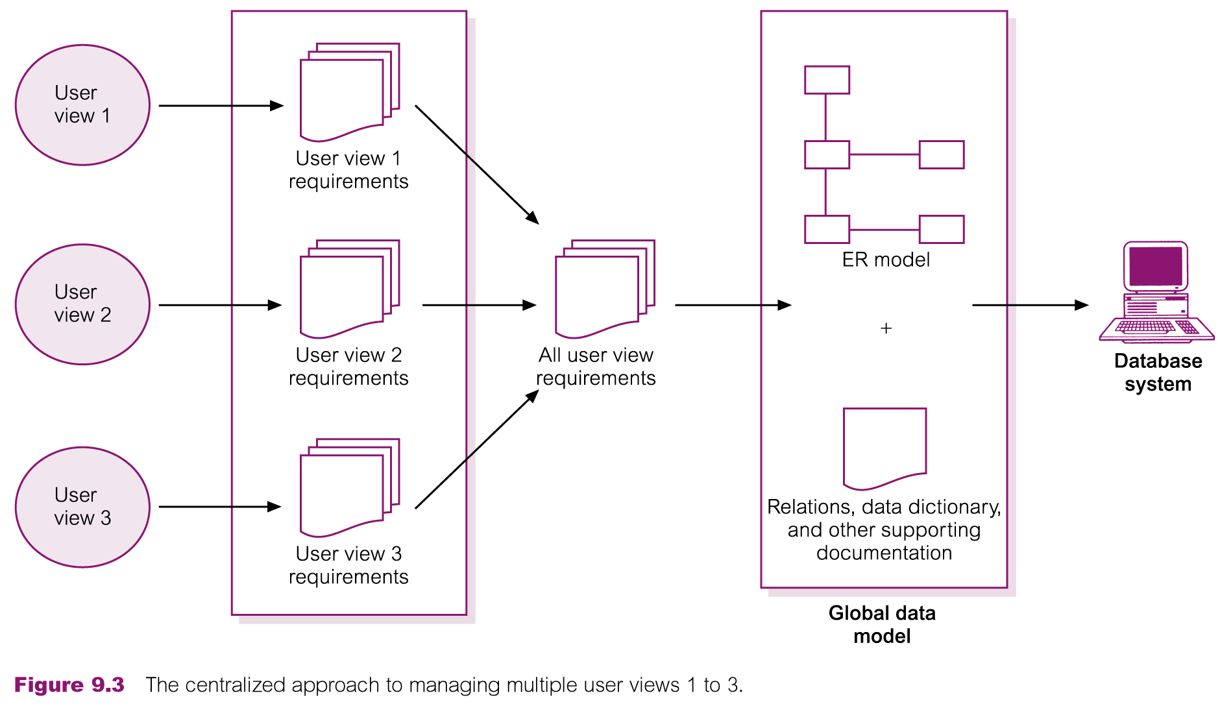
Database System Design
Image from Connolly and Begg (2005)
Notes:
Different applications need different views
Views combined to design data model
User views to support applications:
* efficient query processing
* security by restricting data access

Slide 39
System Definition: User Views
A user view defines what is required of a database system from perspective of:
a particular job role (such as Manager or Supervisor) or
enterprise application area (such as marketing, personnel, or stock control).
For example:
A Director will want to run queries and produce reports at an overall level
A secretary working in one branch will maintain the data and run queries for that branch only
A table might be a good way of showing this

Slide 40
Summary
Database: collection of data
DBMS: system that manages data
Support multiple simultaneous users
Complex system
Three-tier ANSI-SPARC architecture
Secure access control
Database system lifecycle
Identify data requirements
Design database to meet requirements
Deploy and maintain system

Slide 41
References
Codd, E.F., 1982. Relational database: a practical foundation for productivity. Communications of the ACM, 25(2), pp.109–117.
Connolly, T., & Begg, C. (2005). Database Systems: A Practical Approach to Design, Implementation, and Management (4th ed.). Addison Wesley.

